Slide 1
Sales performance dashboard for stationary shop

Slide 2
Stationery shop sales analytics
Astha gaur
Date: 21 august 2025

Slide 3
Goal : Visualize and analyze sales data for a stationery shop
Objectives:
- Identify top-selling products
- Understand revenue trends
Tools Used:
- Python, machine learning, excel
- Tableau Public

Slide 4
Source: sales_clean.csv
Columns:
- Date
- Product
- Units Sold
- Unit Price
- Color
- Total Revenue
Scope: Daily sales across multiple stationery products

Slide 5
items
- 🏆 Notebook: Highest revenue generator
- ✒️ Pen: Most units sold
- 🎨 Decoration Material & Colored Sheet: Strong performers
- 📈 Peak Sales Days: Identified using line chart trends

Slide 6
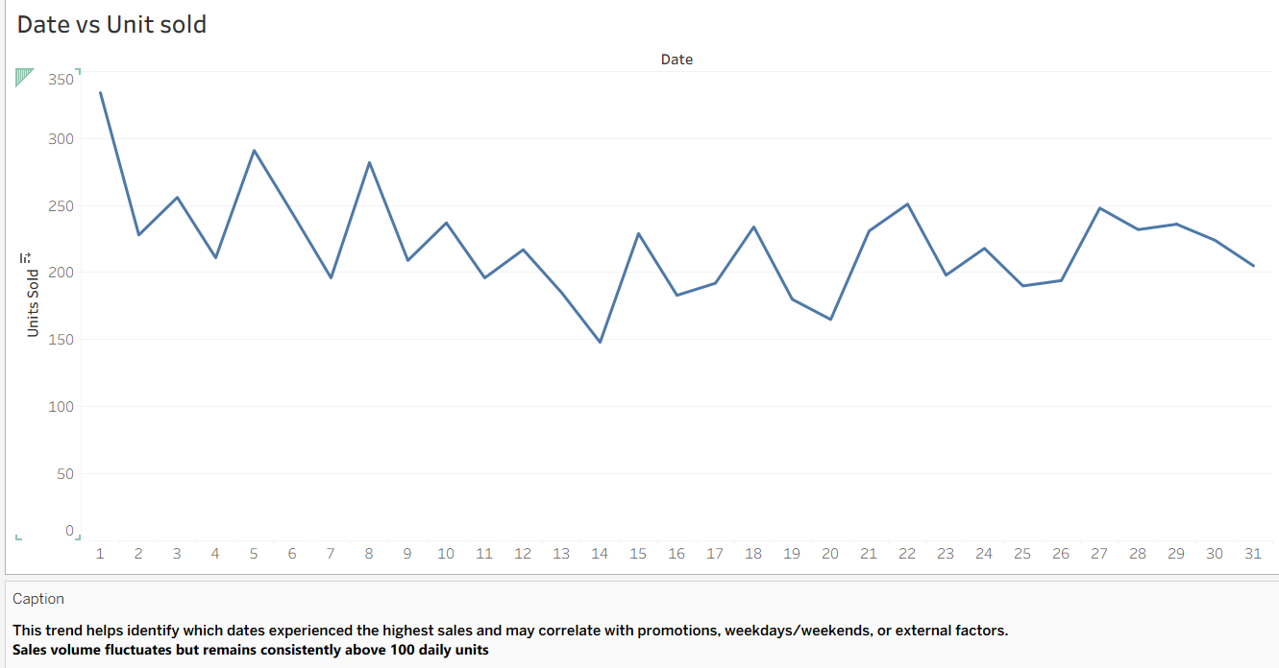

Slide 7
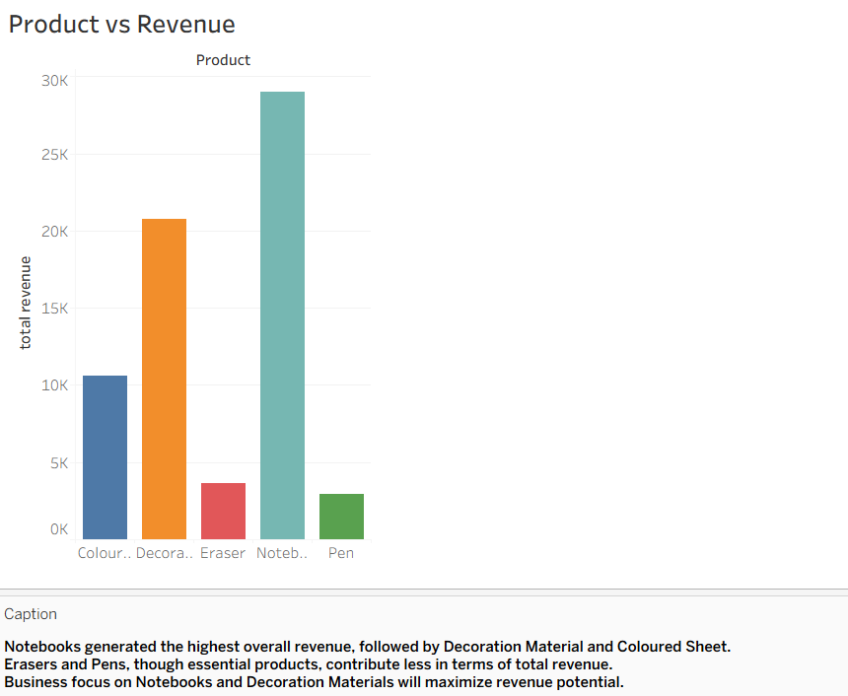

Slide 8
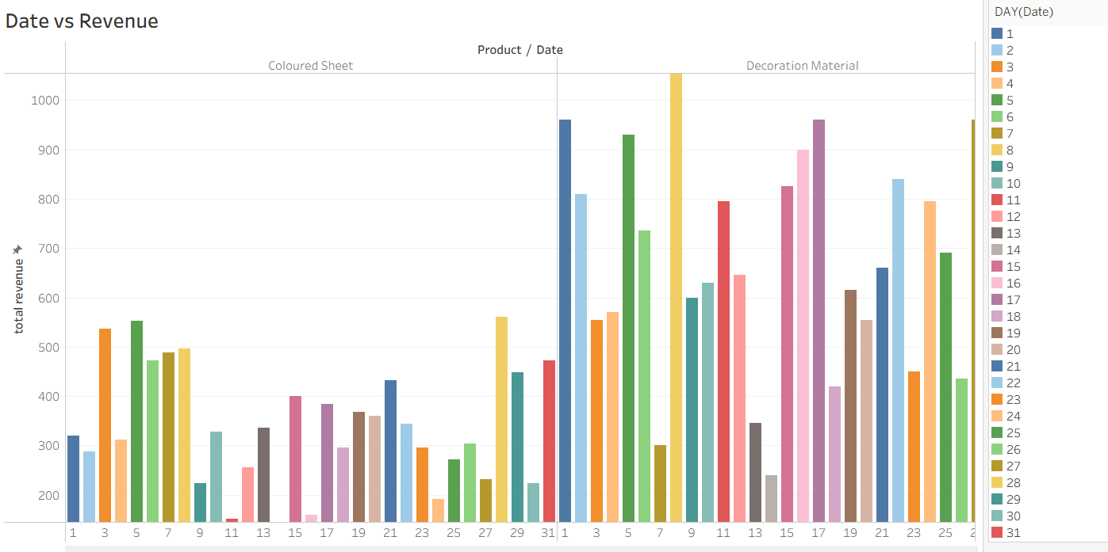

Slide 9
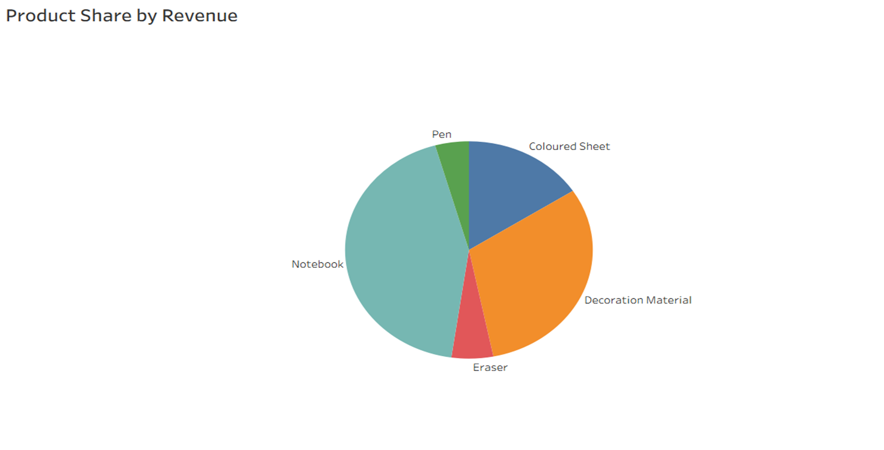

Slide 10
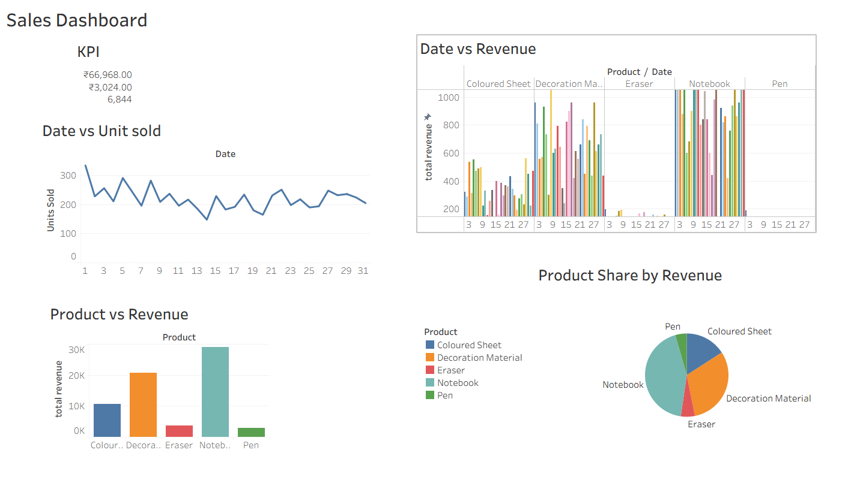

Slide 11
Main points
- 📦 Maintain high inventory for bestsellers (Notebook, Decoration Material)
- 📅 Leverage peak sales days for promotions and marketing
- 🔍 Monitor and improve low-performing products

Slide 12
Thank you
\

